Slide 1


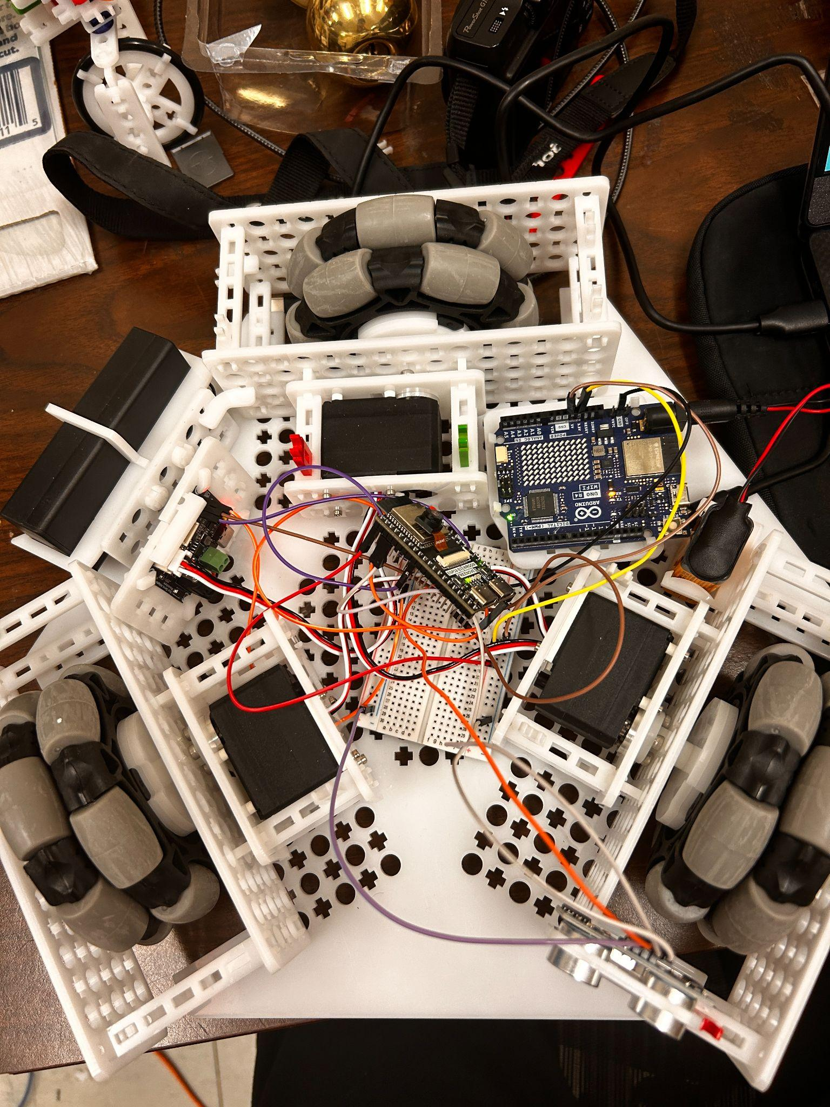
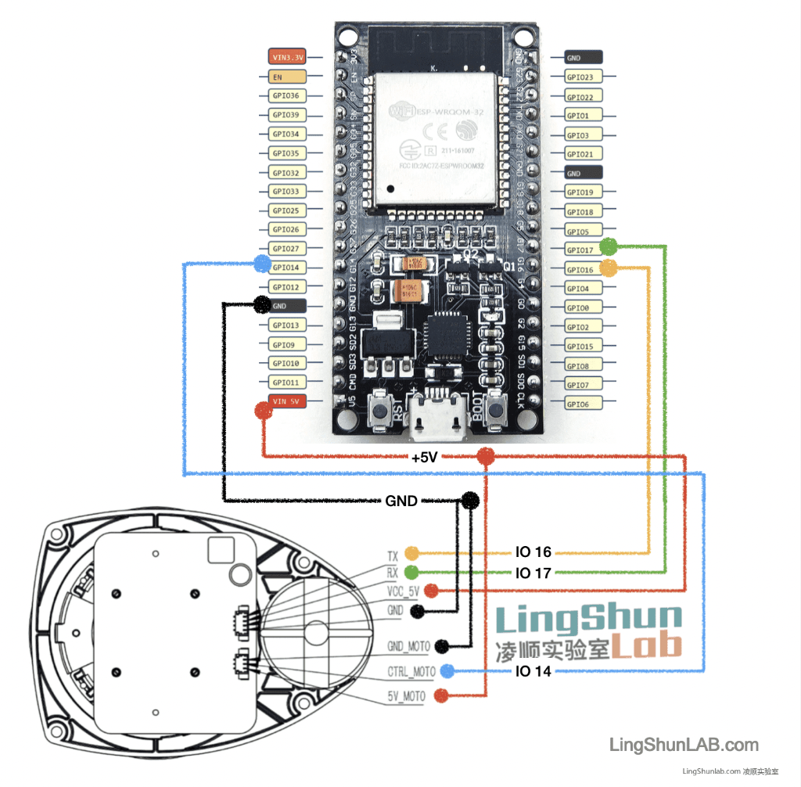
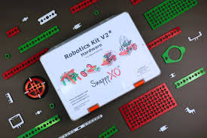
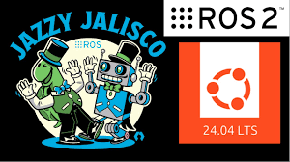
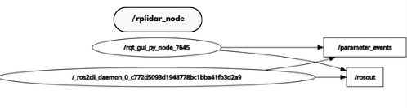
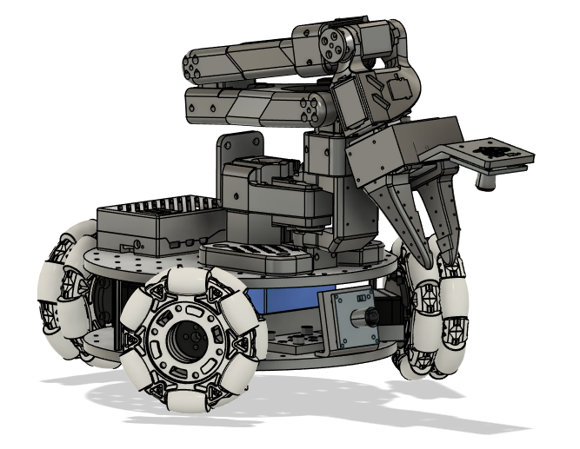
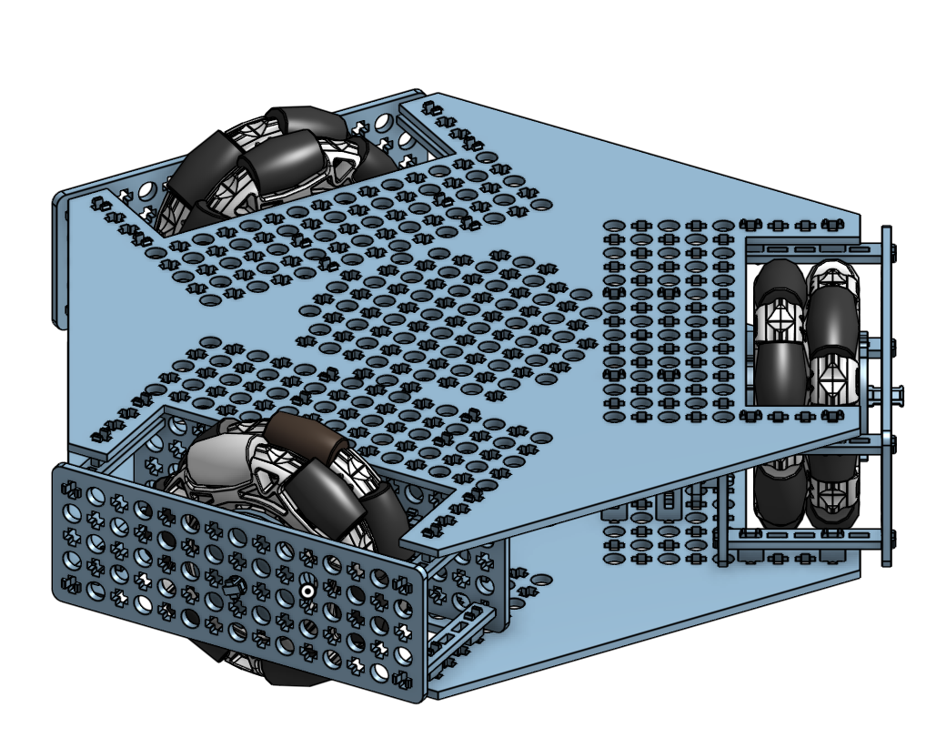
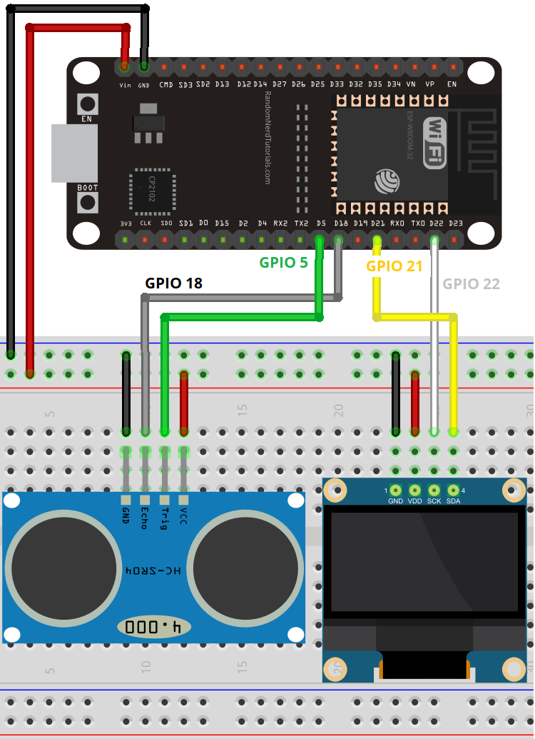
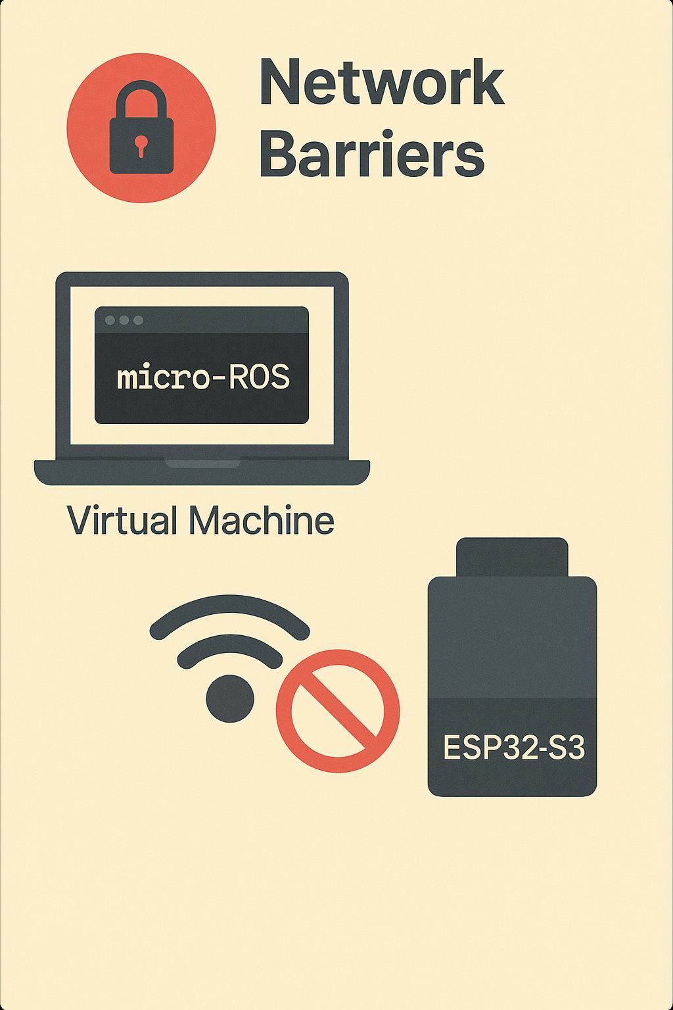
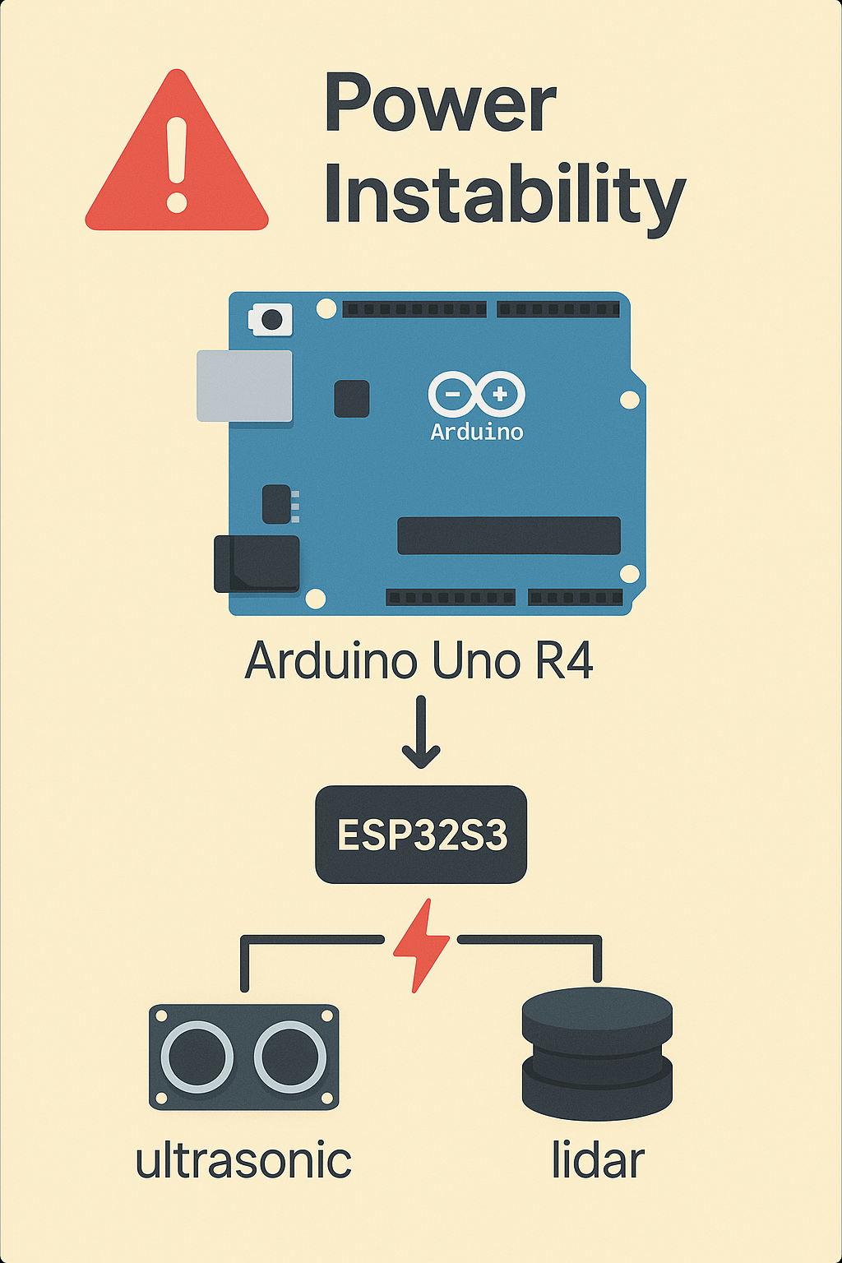
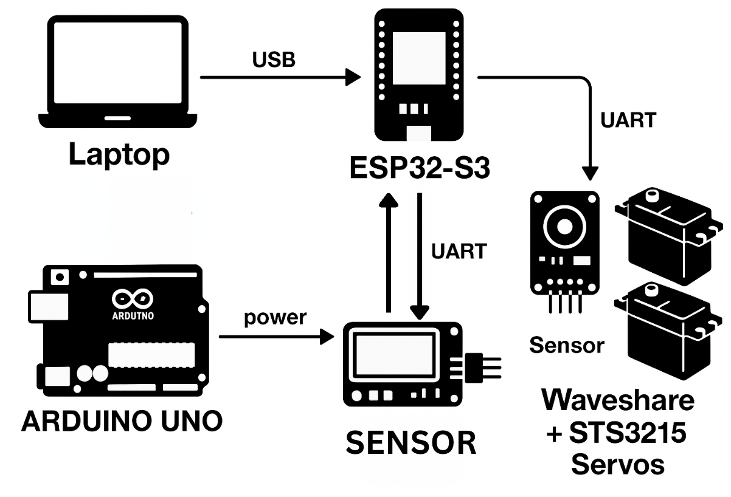
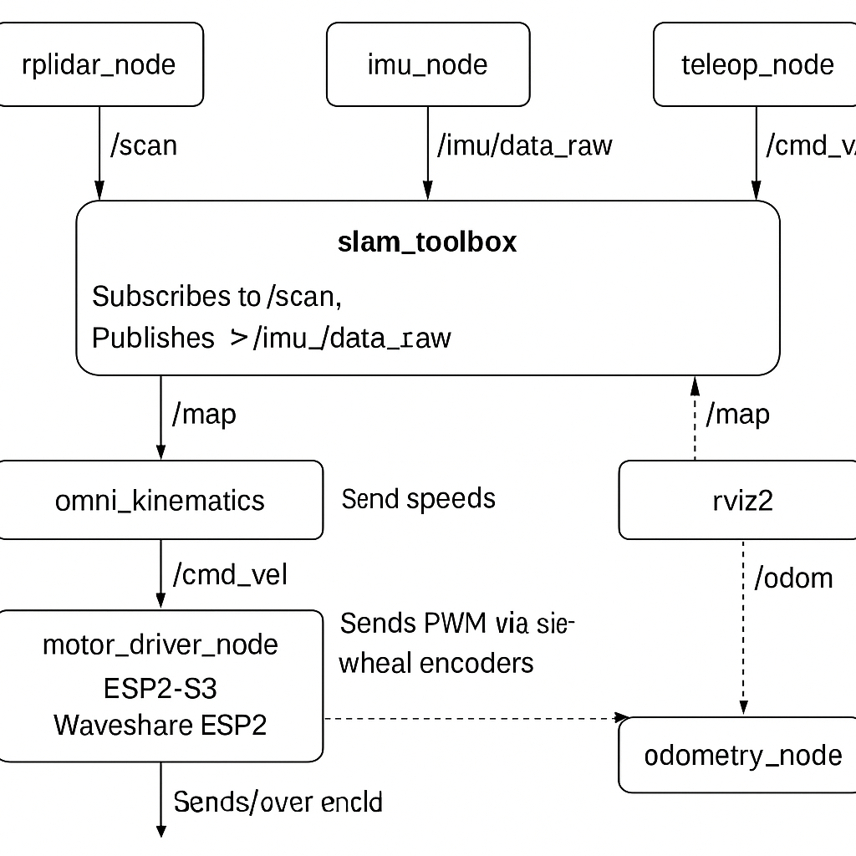
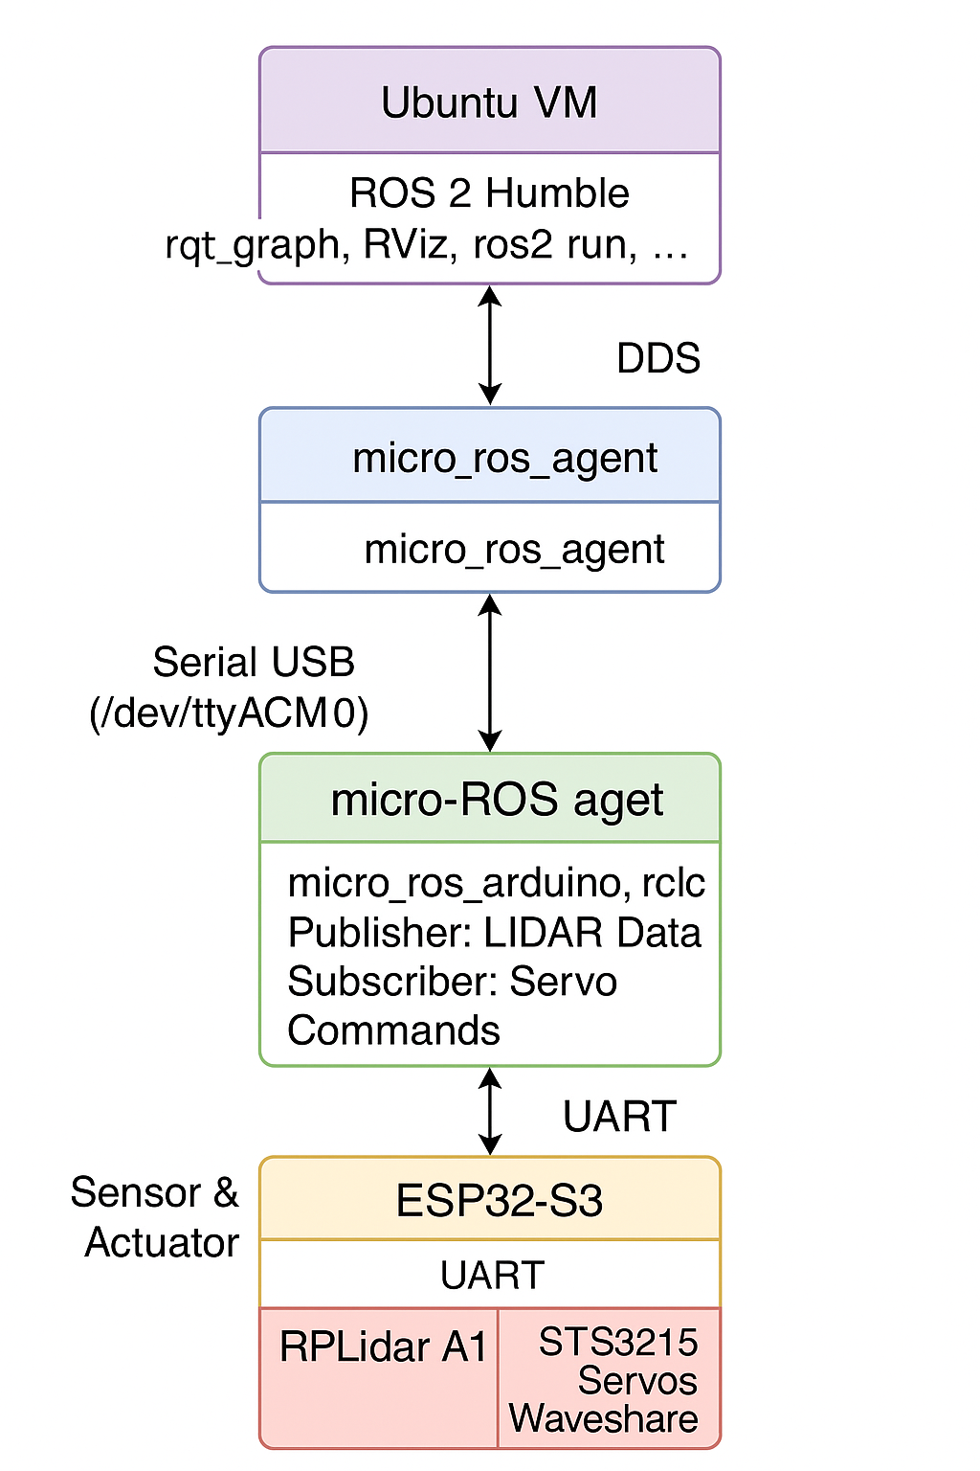
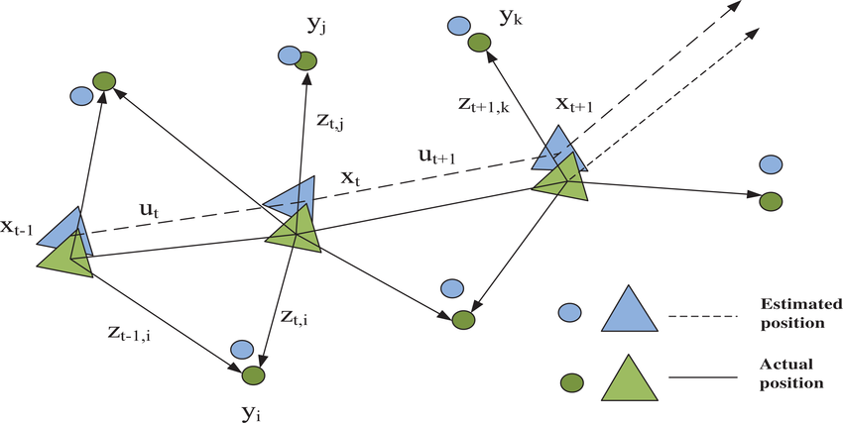
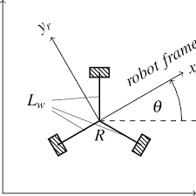
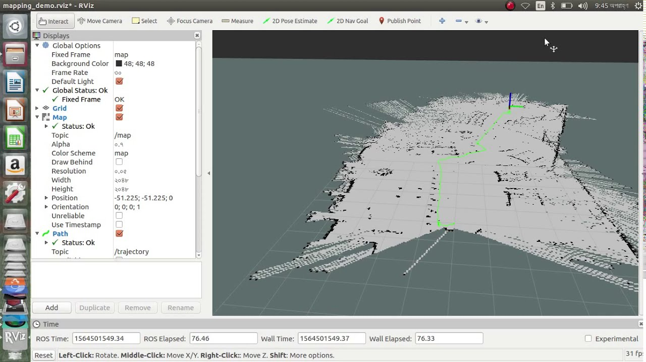
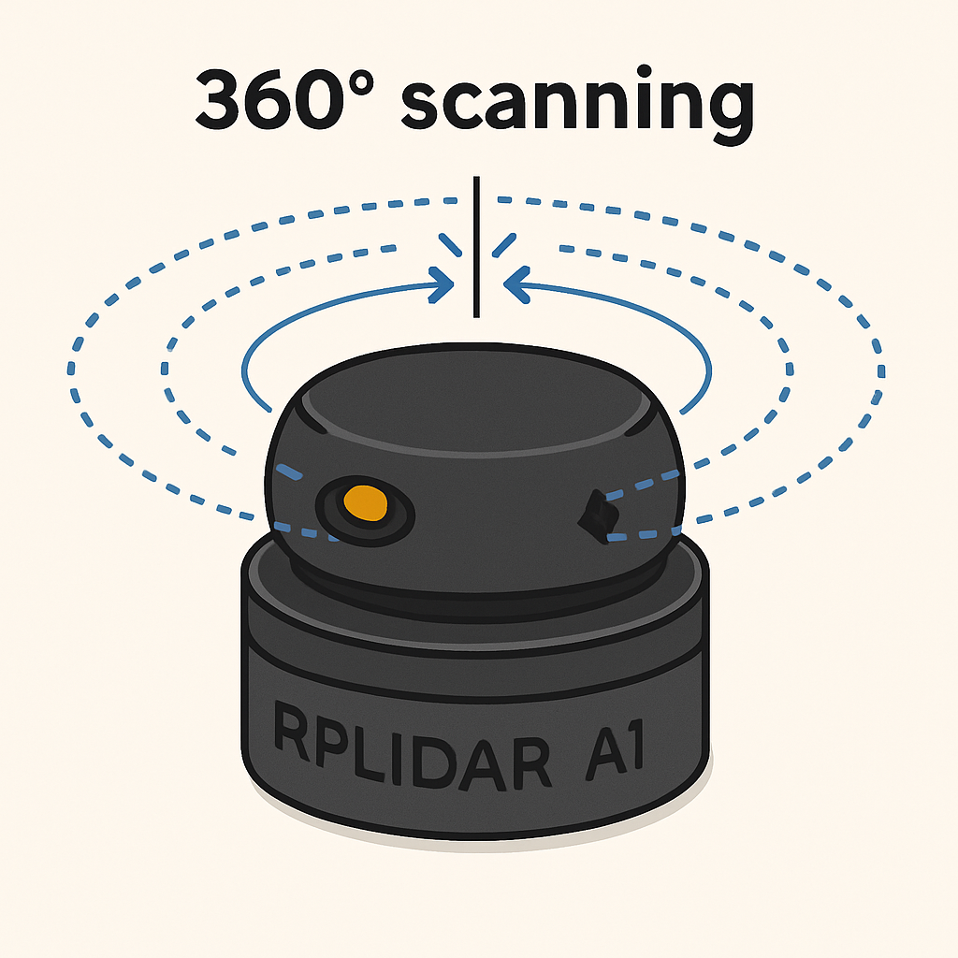
Deploying Micro-ROS on ESP32 for Low-Cost Robotic Pathfinding with the Lekiwi Robot
Hua Huang^{1,3}, Robert Casal^{2,3}, Anurag Purwar^{2,3}
¹Department of Electrical and Computer Engineering, ²Department of Mechanical Engineering, ³Stony Brook University
Introduction
Discussion/Limitations
v
Sensor Noise: Ultrasonic sensors produced unreliable readings due to surface reflections and environmental noise.
Hardware Mismatch: Voltage and communication mismatches between ESP32, Arduino, and sensors complicated integration.
ROS 2 Constraints: micro-ROS lacks full ROS 2 features, limiting message types and debugging tools.
Power Instability: We used Arduino Uno R4 to power the ESP32S3 and sensors(ultrasonic and lidars) and this proved to sometimes be unstable
Debugging Difficulty: Limited access to existing projects with running microROS on esp32s3 to lidars
Network Barriers: Wi-Fi or firewall restrictions blocked micro-ROS communication from virtual machine to the ESP32-S3
Resource Constraints: Limited processing power and memory on ESP32 impacted node reliability.
Redesign of LeKiwi robot using SnappyXO next‑gen hardware.
Full ROS(Robotic Operating Systems) stack runs on laptop, communicating with ESP32‑S3.
Enables real‑time pathfinding, sensor feedback, and distributed control.
Demonstrates low‑cost, scalable ROS 2/Micro‑ROS robotics for research and education.
Methods
Figure 2: Wiring from the ESP32S3 to
RPLidar A1
Robot Platform
LeKiwi robot with three‑omniwheel drive for omnidirectional motion.
Hardware Configuration
laptop -> esp32s3 (USB)
arduino uno -> esp32s3
arduino uno -> sensor
sensor -> esp32s3 (UART)
esp32s3 -> waveshare + sts
Software Architecture
ESP32‑S3: Runs Jazzy Micro‑ROS firmware; publishes encoder data, and forwards them to Waveshare ESP32.
Host Laptop: Runs ROS 2 on Ubuntu virtual machine; processes sensor feedback, and communicates with ESP32‑S3 via USB/Wi‑Fi.
Robot Control
Micro_ros_arduino package for microROS
Velocity commands sent to robot; odometry and sensor data logged for algorithm refinement.
Figure 1: Hardware wiring of Lekiwi
Figure 3: rqt_graph showing communication between topics
Future Implementations
Implement SLAM (Simultaneous Localization and Mapping) using onboard sensors like LiDAR or vision modules to enable self-driving capability.
Web-Based Teleoperation Interface: Develop a lightweight web dashboard hosted on the ESP32-S3 to allow remote control and status monitoring via bluetooth.
Wi-Fi-Based ROS 2 Communication:
Transition from USB to wireless communication between the ESP32-S3 and the ROS 2 host, enabling untethered operation via micro-ROS over Wi-Fi.
Figure 4: complete flow chart of active nodes/topics’
Odometry kinematics of omniwheels
Figure 5: Flow of data in microROS
References
[1]SIGRobotics-UIUC, “GitHub - SIGRobotics-UIUC/LeKiwi: LeKiwi - Low-Cost Mobile Manipulator,” GitHub, 2025. https://github.com/SIGRobotics-UIUC/LeKiwi (accessed June. 20, 2025).
[1]kaiaai, “GitHub - kaiaai/firmware: Platform firmware for Kaia.ai compatible robots,” GitHub, 2024. https://github.com/kaiaai/firmware (accessed Jul. 12, 2025).
‌[1]lingshun, “ESP32 uses RPLidar laser radar to measure distance (RPLidar A1 A1M8),” lingshunlab.com, Aug. 27, 2022. https://lingshunlab.com/book/esp32/esp32-use-rplidar-a1 (accessed Jul. 05, 2025).
Acknowledgments
This project was funded by the State University of New York (SUNY) and the Stony Brook SUNY SOAR Summer Research Program.

